Slide 1
GitHub 101

Slide 2
Creating An Account
Go to GitHub.com to create an account
Wait for an invitation to join Chap Research
You will be added to the appropriate projects

Slide 3
Adding Authentication
You will need an SSH key when committing files
This is to prove you are who you say you are
Log into your account on the server
Create a public-private SSH key pair using
ssh-keygen
Go ahead and use the default (hit enter)
Don’t enter a passphrase (just hit enter)
Copy the contents of the .pub file to your clipboard (from a cat of the file)
Open your GitHub account
Go to settings
Add the SSH public key

Slide 4
Configuring Settings
Now navigate to your working directory
For CROMA, this is /var/www-croma-git/CROMA
To add your name and email:
git config --global user.name “Test User”
git config --global user.email test@example.com
To view current settings:
git config --list
Note that several other settings are already configured for you:
Which file types to ignore (in .git/info/exclude)
Anything ending in ~ or #
Which editor to use for commit messages (core.editor)
Emacs!

Slide 5
Basic Commands
To check the status:
git status
To add files to be committed:
git add <filename>
To commit staged files
git commit
To push changes to remote repository (aka the GitHub website)
git push

Slide 6
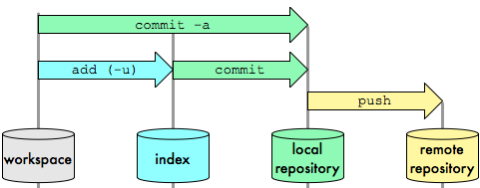
Basic Git Workflow
http://blog.osteele.com/posts/2008/05/my-git-workflow/

